Slide 1
System Programming

Slide 2
System Programming
System programming is the activity of programming system software.
Difference b/t System Programming & Application Programming :
Application programming aims to produce software which provides services to the user (e.g. word processor),
whereas Systems programming aims to produce software which provides services to the computer hardware.

Slide 3
System Programming…
Applications Software | Systems Software
Deals with abstractions like customers, products, orders, balance sheets, employees, and players in a game. | Deals with concepts extremely close to the hardware level, like registers and memory locations.
Solves problems of interest to humans, usually in application areas like health care, game playing, finance... | Controls and manages computer systems
Concerned with anything high-level | Concerned with data transfer, reading from and writing to files, compiling, linking, loading, starting and stopping programs, and even fiddling with the individual bits of a small word of memory
Is almost always device or platform independent; programs concentrate on general-purpose algorithms | Deals with writing device drivers and operating systems, or at least directly using them; programmers exploit this low-level knowledge

Slide 4
System Software
The system software includes
Compiler
Assembler
Linker
Loader
Macro processor
Operating system
Debugging system

Slide 5
Need Of System Software
The basic need of system software is to achieve the following goals :
To achieve efficient performance of the system
To make effective execution of general user program
To make effective utilization of human resources
To make available new, better facilities

Slide 6
Language Processing System
Computer system is made of hardware and software.
The hardware understands a language, which humans cannot understand.
So write programs in high-level language, which is easier to understand and remember.
These programs are then fed into a series of tools and OS components to get the desired code that can be used by the machine.
This is known as Language Processing System.

Slide 7
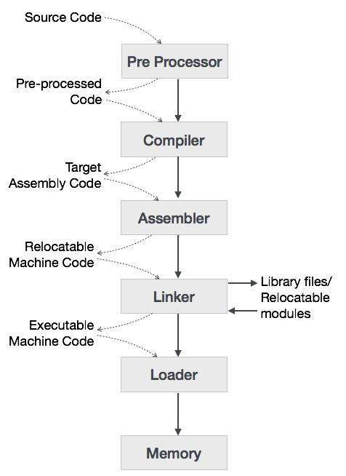

Slide 8
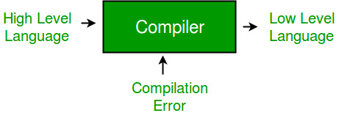
Compiler
A compiler is a software program that transforms high-level source code that is written by a developer in a high-level programming language into a low level object code (binary code) in machine language, which can be understood by the processor.
The process of converting high-level programming into machine language is known as compilation.

Slide 9
Compiler…
Cross Compiler
Runs on a machine ‘A’ and produces a code for another machine ‘B’. It is capable of creating code for a platform other than the one on which the compiler is running.
Source-to-source Compiler
Compiler that translates source code written in one programming language into source code of another programming language.

Slide 10
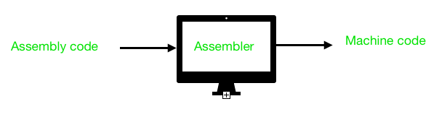
Assembler
Assembler is a program for converting instructions written in low-level assembly code into relocatable machine code and generating along information for the loader.

Slide 11
Assembler…
It generates instructions by evaluating the mnemonics (symbols) in operation field and find the value of symbol and literals to produce machine code.
If assembler do all this work in one scan then it is called single pass assembler, otherwise if it does in multiple scans then called multiple pass assembler.
Here assembler divide these tasks in two passes:
Pass-1:
Define symbols and literals and remember them in symbol table and literal table respectively.
Keep track of location counter
Process pseudo-operations
Pass-2:
Generate object code by converting symbolic op-code into respective numeric op-code
Generate data for literals and look for values of symbols

Slide 12
Linking and Linker
Linking
The Process of merging many object modules to form a single object program is called as linking.
Linker
The Linker is the software program which binds many object modules to make a single object program.

Slide 13
Loader
Once the assembler produces an object program, that program must be placed into memory and executed.
It is the purpose of the loader to assure that object programs are placed in memory in an executable form.
The assembler could place the object program directly in memory and transfer control to it, thereby causing the machine language program to be executed.
However this would waste memory by leaving the assembler in memory while the user’s program was being executed.
Also the programmer would have to retranslate his program with each execution, thus wasting translation time.
To overcome the problem of wasted translation time and wasted memory, system programmers developed another component, called the Loader.

Slide 14
Loader…
Loader is a program that places programs into memory and prepares them for execution.
In a simple loading scheme, the assembler outputs the machine language translation of a program on a secondary storage device and a loader is placed in memory
The loader places into memory the machine language version of the user’s program & transfers control to it.
Since the loader program is much smaller then the assembler, this makes more memory available to the user’s program.

Slide 15
Macro processor
A macro processor is a program that reads a file (or files) and scans them for certain keywords. When a keyword is found, it is replaced by some text. The keyword/text combination is called a macro.
A simple example is the C language preprocessor.
When you write
#define MAX_BANANAS 6
int banana;
for (banana = 0; banana < MAX_BANANAS; banana++){ ...; }
In a C program, the C preprocessor reads the first line and stores it as a macro definition.
When it comes across the later reference to MAX_BANANAS in the for loop, it replaces it with the macro's definition, 6.
The output of the C preprocessor is then fed to the C compiler proper.

Slide 16
Formal System
A formal system is used for inferring theorems from axioms according to a set of rules.
These rules, which are used for carrying out the inference of theorems from axioms, are the logical calculus of the formal system.
A formal system is essentially an "axiomatic system“.

Slide 17
Formal System…
Each formal system uses primitive symbols (which collectively form an alphabet) to finitely construct a formal language from a set of axioms through inferential rules of formation.
The system thus consists of valid formulas built up through finite combinations of the primitive symbols—combinations that are formed from the axioms in accordance with the stated rules.
This can be expressed as the following:
A finite set of symbols, known as the alphabet, which concatenate formulas, so that a formula is just a finite string of symbols taken from the alphabet.
A set of axioms, or axiom schemata, consisting of well-formed formulas.
A set of inference rules. A well-formed formula that can be inferred from the axioms is known as a theorem of the formal system.

Slide 18
References
https://en.wikipedia.org/
https://www.geeksforgeeks.org/
https://www.tutorialspoint.com/

